Slide 1
FINITE STATE AUTOMATA
Session 25-26
Course : Z0184-Discrete Mathematics
Effective Period : September 2017

Slide 2
These slides have been adapted from:
Susanna S.Epp. (2010). Discrete Mathematics with Applications.4th edition. Thomson Brooks/Cole. USA. ISBN: 9780534359454
Chapter 12
Acknowledgement

Slide 3
On successful completion of this Course, students will be able to:
Learning Objectives
LO 1: Explain the logic of compound and quantified statements and how do to proof
LO 2: Explain and applying Set Theory, Counting method and Number Theory
LO 3: Explain Function, recursion, fuzzy set, Relations and Graph Theory
LO 4: Explain Trees & Graph theory and its application
LO 5: Explain Automata and graph its application in computer science

Slide 4
Finite State Automata
The world of the future will be an ever more demanding struggle against the limitations
our intelligence, not a comfortable hammock in which we can lie down to be waited
upon by our robot slaves.
— Norbert Wiener, 1964

Slide 5
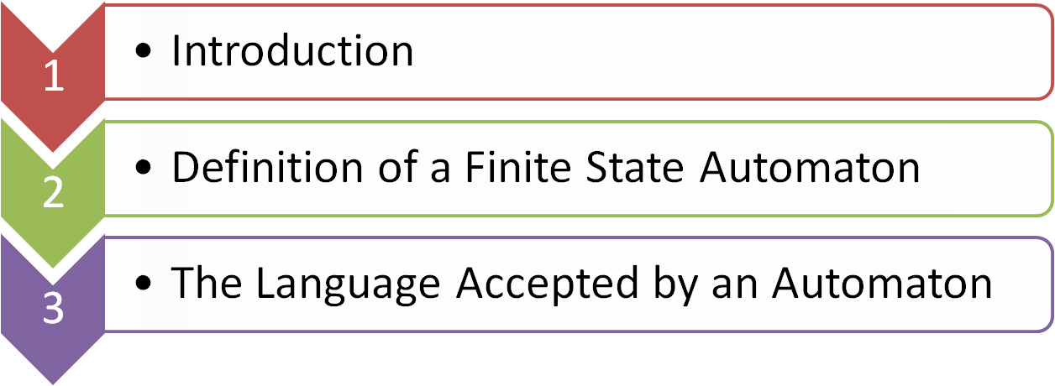

Outline
Designing a Finite-State Automaton

Slide 6
INTRODUCTION

Slide 7
Finite State Automaton
Finite-state automaton is an idealized machine that embodies the essential idea of a sequential circuit.
Each piece of input to a finite-state automaton leads to a change in the state of the automaton, which in turn affects how subsequent input is processed.
for example, Vending machines operation.

Slide 8
Example : A Simple Vending Machine (1)
A simple vending machine dispenses bottles of juice that cost $1 each. The machine accepts quarters and half-dollars only and does not give change. As soon as the amount deposited equals or exceeds $1 the machine releases a bottle of juice. The next coin deposited starts the process over again. The operation of the machine is represented by the diagram of Figure 12.2.1.

Slide 9
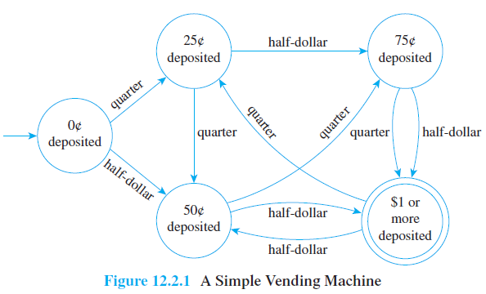
Transition diagram :
A Simple Vending Machine (2)

Slide 10
Example : A Simple Vending Machine (3)
Each circle represents a state of the machine: the state in which 0c/ has been deposited, 25c , 50c , 75c , and $1 or more.
The unlabeled arrow pointing to “0c deposited” indicates that this is the initial state of the machine.
The double circle around “$1 or more deposited” indicates that a bottle of juice is released when the machine has reached this state.

Slide 11
Example : A Simple Vending Machine (4)
The arrows that link the states indicate what happens when a particular input is made to the machine in each of its various states.
For instance, the arrow labeled “quarter” that goes from “0c deposited” to “25c deposited” indicates that when the machine is in the state “0c deposited” and a quarter is inserted, the machine goes to the state “25c deposited.”

Slide 12
Example : A Simple Vending Machine (5)
The arrow labeled “half-dollar” that goes from “75c deposited” to “$1 or more deposited” indicates that when the machine is in the state “75c deposited” and a half-dollar is inserted, the machine goes to the state “$1 or more deposited” and juice is dispensed. (In this case the purchaser would pay $1.25 for the juice because the machine does not return change.)

Slide 13
Example : A Simple Vending Machine (6)
The arrow labeled “quarter” that goes from “$1 or more deposited” to “25c/ deposited” indicates that when the machine is in the state “$1 or more deposited” and a quater is inserted, the machine goes back to the state “25c/ deposited.”
(This corresponds to the fact that after the machine has dispensed a bottle of juice, it starts operation all over again.)

Slide 14
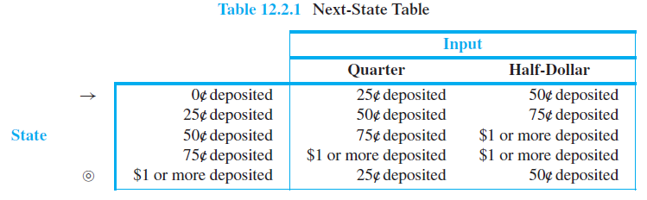
Example : A Simple Vending Machine (7)
vending machine can be represented by a next-state table as shown in Table 12.2.1.

Slide 15
Example : A Simple Vending Machine (8)
The arrow pointing to “0c/ deposited” in the table indicates that the machine begins operation in this state. The double circle next to “$1 or more deposited” indicates that abottle of juice is released when the machine has reached this state.
Entries in the body of the table are interpreted in the obvious way. For instance, the entry in the third row of the column labeled Half-Dollar shows that when the machine is in state “50c deposited” and a half-dollar is deposited, it goes to state “$1 or more deposited.”

Slide 16
DEFINITION OF A FINITE-STATE AUTOMATON

Slide 17
Formal definition
A finite-state automaton A consists of five objects:
1. A finite set I, called the input alphabet, of input symbols;
2. A finite set S of states the automaton can be in;
3. A designated state s0 called the initial state;
4. A designated set of states called the set of accepting states;
5. A next-state function N: S × I → S that associates a “next-state” to each ordered pair consisting of a “current state” and a “current input.” For each state s in S and input symbol m in I, N(s,m) is the state to which A goes if m is input to A when A is in state s.

Slide 18
A FSA Given by a Transition Diagram
Consider the finite-state automaton A defined by the transition diagram shown in Figure 12.2.2.
a. What are the states of A?
b. What are the input symbols of A?
c. What is the initial state of A?
d. What are the accepting states of A?
e. Determine N(s1, 1).
f. Construct the annotated next-state table for A.

Slide 19
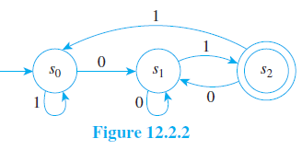
A FSA Given by a Transition Diagram

Slide 20
A FSA Given by a Transition Diagram
Solution :
The states of A are s0, s1, and s2 [since these are the labels of the circles].
The input symbols of A are 0 and 1 [since these are the labels of the arrows].
c. The initial state of A is s0 [since the unlabeled arrow points to s0].
d. The only accepting state of A is s2 [since this is the only state marked by a double circle].

Slide 21
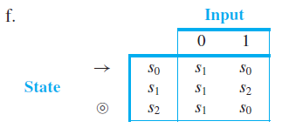
A FSA Given by a Transition Diagram
Solution (Cont’d) :
e. N(s1, 1) = s2 [since there is an arrow from s1 to s2 labeled 1].

Slide 22
A FSA by an Annotated Next-State Table
Consider the finite-state automaton A defined by the following annotated next-state table:
a. What are the states of A?
b. What are the input symbols of A?
c. What is the initial state of A?
d. What are the accepting states of A?
e. Find N(U, c).
f. Draw the transition diagram for A.

Slide 23
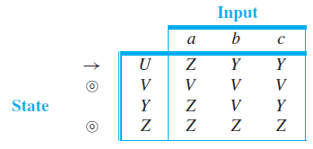
A FSA by an Annotated Next-State Table

Slide 24
A FSA by an Annotated Next-State Table
Solution :
a. The states of A are U, V, Y, and Z.
b. The input symbols of A are a, b, and c.
c. The initial state of A is U [since the arrow points to U].
d. The accepting states of A are V and Z [since these are marked with double circles].
e. N(U, c) = Y [since the entry in the row labeled U and the column labeled c of the next-state table is Y ].

Slide 25
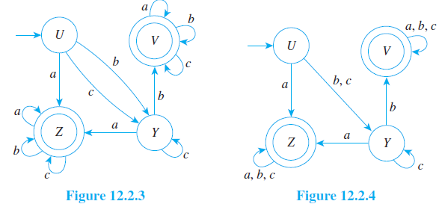
A FSA by an Annotated Next-State Table
f. The transition diagram for A is shown in Figure 12.2.3. It can be drawn more compactlyby labeling arrows with multiple-input symbols where appropriate in Figure 12.2.4.

Slide 26
THE LANGUAGE ACCEPTED BY AN AUTOMATON

Slide 27
The Language Accepted by an Automaton
a string of input symbols is fed into a finite-state automaton in sequence.
At the end of the process, after each successive input symbol has changed the state of the automaton, the automaton ends up in a certain state, which may be either an accepting state or a nonaccepting state.
Those strings that send the automaton to an accepting state are said to be accepted by the automaton

Slide 28
The Language Accepted by an Automaton
Let A be a finite-state automaton with set of input symbols I. Let I ∗ be the set of all strings over I , and let w be a string in I ∗. Then w is accepted by A if, and only if, A goes to an accepting state when the symbols of w are input to A in sequence from left to right, starting when A is in its initial state. The language accepted by A, denoted L(A), is the set of all strings that are accepted by A.

Slide 29
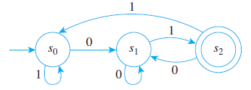
Finding the Language Accepted by an Automaton
Consider the finite-state automaton A defined in Example 12.2.2 and shown again below

Slide 30
Finding the Language Accepted by an Automaton
a. To what states does A go if the symbols of the following strings are input to A in sequence, starting from the initial state?
(i) 01 (ii) 0011 (iii) 0101100 (iv) 10101
b. Which of the strings in part (a) send A to an accepting state?
c. What is the language accepted by A?
d. Is there a regular expression that defines the same language?

Slide 31
Finding the Language Accepted by an Automaton
Solution :
a. (i) s2 (ii) s0 (iii) s1 (iv) s2
b. The strings 01 and 10101 send A to an accepting state.
c. Observe that if w is any string that ends in 01, then w is accepted by A. For if w is any string of length n ≥ 2, then after the first n − 2 symbols of w have been input, A is in one of its three states: s0, s1, or s2. But from any of these three states, input of the symbols 01 in sequence sends A first to s1 and then to the accepting state s2. Hence any string that ends in 01 is accepted by A.

Slide 32
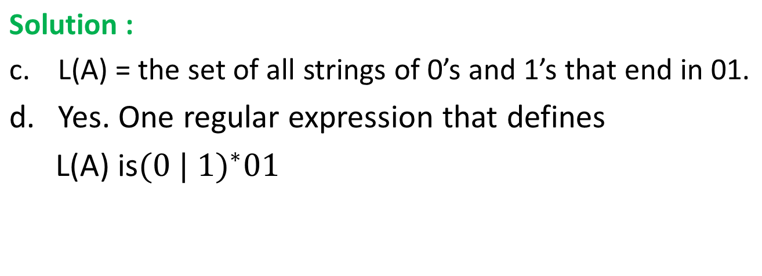
Finding the Language Accepted by an Automaton

Slide 33
DESIGNING A FINITE-STATE AUTOMATON

Slide 34
Designing a Finite-State Automaton
Example 1:
a. Design a finite-state automaton A that accepts the set of all strings of 0’s and 1’s such that the number of 1’s in the string is divisible by 3.
b. Is there a regular expression that defines this set?

Slide 35
Designing a Finite-State Automaton
Solution
a. Let s0 be the initial state of A, s1 its state after one 1 has been input, and s2 its state after two 1’s have been input. Note that s0 is the state of A after zero 1’s have been input, and since zero is divisible by 3 (0 = 0·3), s0 must be an accepting state. The states s0, s1, and s2 must be different from one another because from state s0 three 1’s are needed to reach a new total divisible by 3, whereas from state s1 two additional 1’s are necessary, and from state s2 just one more 1 is required.

Slide 36
Designing a Finite-State Automaton
Now the state of A after three 1’s have been input can also be taken to be s0 because after three 1’s have been input, three more are needed to reach a new total
divisible by 3. More generally, if 3k 1’s have been input to A, where k is any nonnegative integer, then three more are needed for the total again to be divisible by 3 (since 3k + 3 = 3(k + 1)). Thus the state in which 3k 1’s have been input, for any nonnegative integer k, can be taken to be the initial state s0.

Slide 37
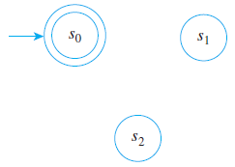
Designing a Finite-State Automaton
By similar reasoning, the states in which (3k + 1) 1’s and (3k + 2) 1’s have been input, where k is a nonnegative integer, can be taken to be s1 and s2, respectively. Now every nonnegative integer
can be written in one of
the three forms 3k, 3k + 1,
or 3k + 2 (see Section 4.4),
so the three states s0, s1,
and s2 are all that is needed
to create A.

Slide 38
Designing a Finite-State Automaton
Next consider the possible inputs to A in each of its states. No matter what state A is in, if a 0 is input the total number of 1’s in the input string remains unchanged. Thus there is a loop at each state labeled 0.
Now suppose a 1 is input to A when it is in state s0. Then A goes to state s1 (since the total number of 1’s in the input string has changed from 3k to 3k + 1). Similarly, if a 1 is input to A when it is in state s1, then A goes to state s2 (since the total number of 1’s in the input string has changed from 3k + 1 to 3k + 2)

Slide 39
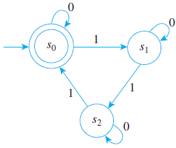

Designing a Finite-State Automaton
Finally, if a 1 is input to A when it is in state s2, then it goes to state s0 (since the total number of 1’s in the input string becomes (3k + 2) + 1 = 3k + 3 = 3(k + 1), which is a multiple of 3.). The transition diagram for A has the appearance shown below.
b. A regular expression that defines the given set is

Slide 40
Designing a Finite-State Automaton
Example 2 :
a. Design a finite-state automaton A to accept the set of all strings of 0’s and 1’s that contain exactly one 1.
b. Is there a regular expression that defines this set?

Slide 41
Designing a Finite-State Automaton
Solution:
a. The automaton A must have at least two distinct states:
s0: initial state;
s1: state to which A goes when the input string contains exactly one 1.
If A is in state s0 and a 0 is input, A may as well stay in state s0 (since it still needs to wait for a 1 to move to state s1), but as soon as a 1 is input, A moves to state s1.

Slide 42
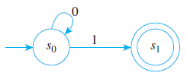
Designing a Finite-State Automaton
Solution (cont’d):
Thus a partial drawing of the transition diagram is as shown below

Slide 43
Designing a Finite-State Automaton
Solution:
Now consider what happens when A is in state s1. If a 0 is input, the input string still has a single 1, so A stays in state s1. But if a 1 is input, then the input string contains more than one 1, so A must leave s1 (since no string with more than one 1 is to be accepted by A). It cannot go back to state s0 because there is a way to get from s0 to s1, and after input of the second 1, A can never return to state s1. Hence A must go to a third state, s2, from which there is no return to s1. Thus from s2 every input may as well leave A in state s2

Slide 44
Designing a Finite-State Automaton
Solution:
Now consider what happens when A is in state s1. If a 0 is input, the input string still has a single 1, so A stays in state s1. But if a 1 is input, then the input string contains more than one 1, so A must leave s1 (since no string with more than one 1 is to be accepted by A). It cannot go back to state s0 because there is a way to get from s0 to s1, and after input of the second 1, A can never return to state s1. Hence A must go to a third state, s2, from which there is no return to s1. Thus from s2 every input may as well leave A in state s2

Slide 45
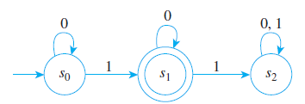
Designing a Finite-State Automaton
Solution:
The Diagram transition
b. A regular expression that defines the given set is

Slide 46
Reference
Susanna S.Epp. (2015). Discrete Mathematics with Applications.5th edition. Thomson Brooks/Cole. USA. ISBN: 9780534359454

